Slide 1
Experience with Hypersim on developing Digital Twins of modern power grids
Vinícius Albernaz Lacerda
Lecturer
CITCEA-UPC, Polytechnic University of Catalonia, Barcelona, Spain

Slide 2
INTRODUCTION
The energy transition is transforming the way we used to control, operate, protect, measure and simulate power systems.
The slow electromechanical dynamics now are being replaced by fast electromagnetic dynamics.
In such a fast-paced context, power grids require a substantial improvement in real-time operation and short-term planning.
The HP2C-DT project aims to tackle those challenges.

Slide 3
THE HP2C-DT PROJECT
The energy transition is transforming the way we used to control, operate, protect, measure and simulate power systems.
The slow electromechanical dynamics now are being replaced by fast electromagnetic dynamics.
In such a fast-paced context, power grids require a substantial improvement in real-time operation and short-term planning.
The HP2C-DT project aims to tackle those challenges.

Slide 4
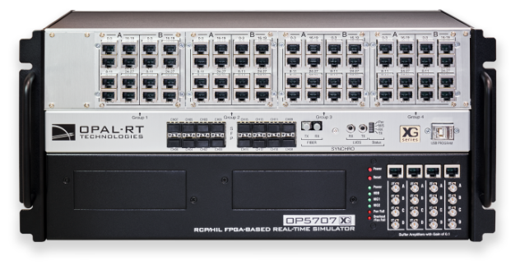
EXAMPLE SLIDE
Helping the world build better products
OPAL-RT believes in empowering engineers and researchers with accessible, cutting-edge, real-time simulation technology in order to accelerate the availability of greater products and more reliable energy transmission.

Slide 5
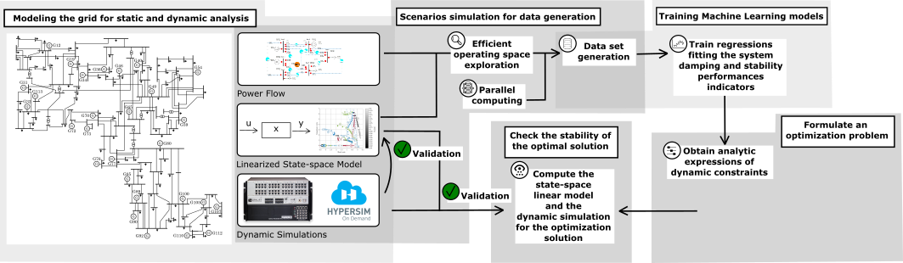
EXAMPLE SLIDE

Slide 6
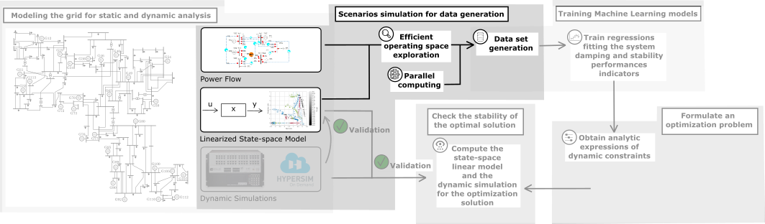
EXAMPLE SLIDE

Slide 7
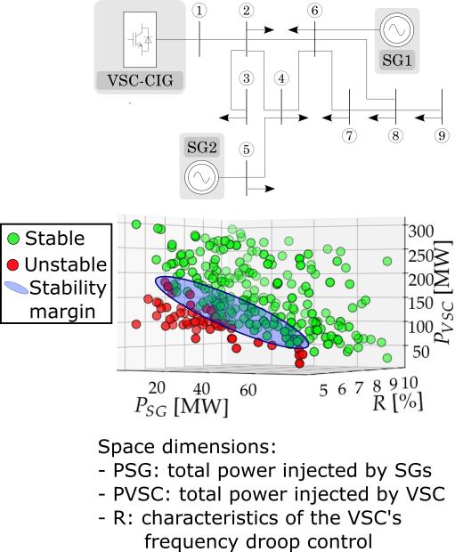
Data Generation
Create a high-information content data set avoiding curse-of-dimensionality:
Explore the entire operating space of the system (different operating points, different converters’ control modes, etc.)
Select a limited number of significative samples, by the Latin Hypercube Sampling strategy
Orient sampling towards the stability margin of the system, by the use of the Entropy function
→ Sequential algorithm for efficient data set generation

Slide 8
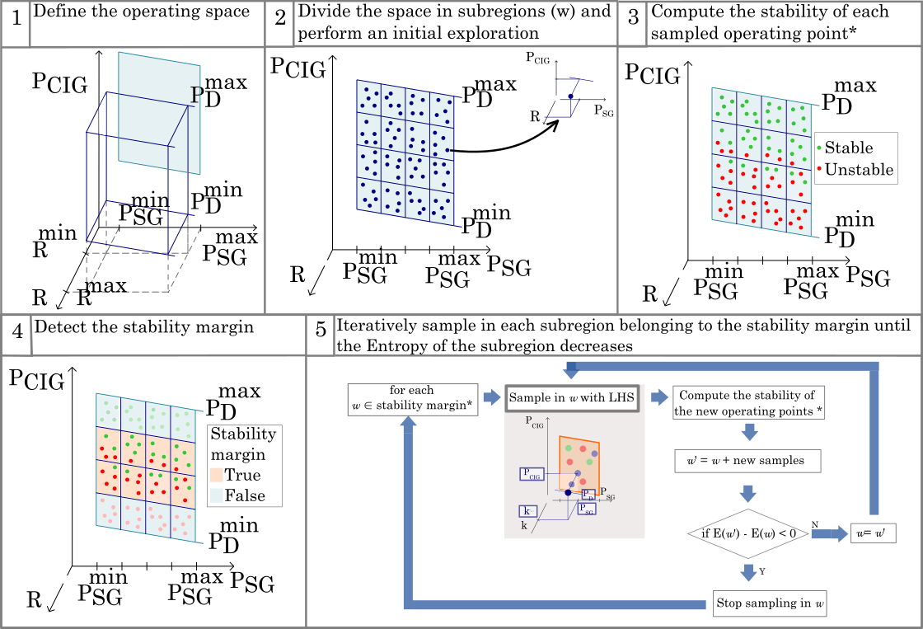
Data Generation
* Parallelizable task

